Slide 1
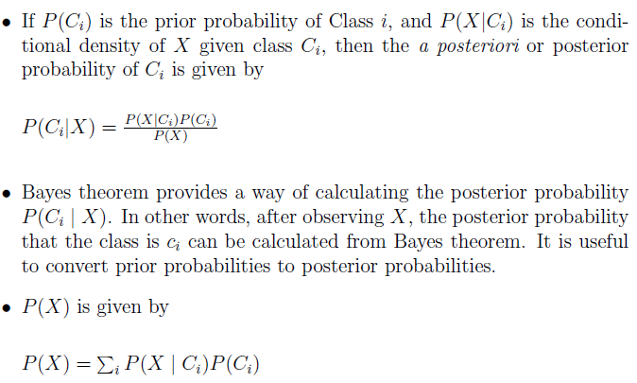

BAYES CLASSIFIER

Slide 2
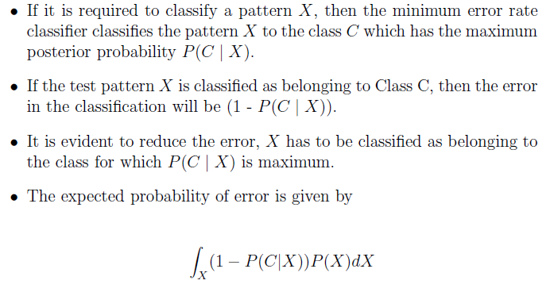
Minimum Error Rate Classification

Slide 3
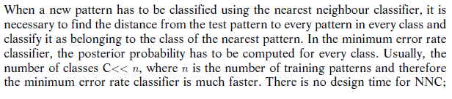
Comparison with NNC

Slide 4
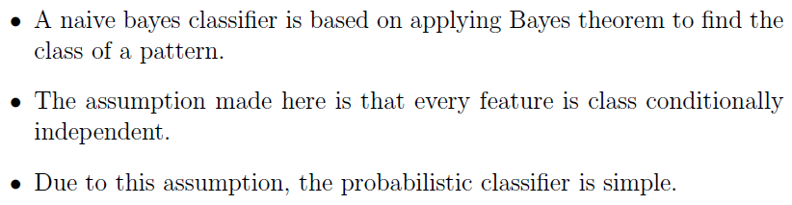
NAÏVE BAYES CLASSIFIER

Slide 5
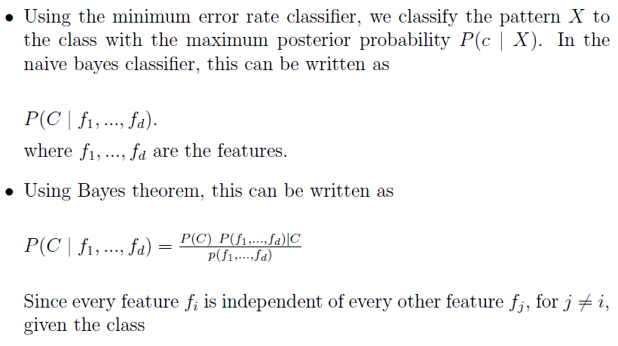
NAÏVE BAYES CLASSIFIER

Slide 6
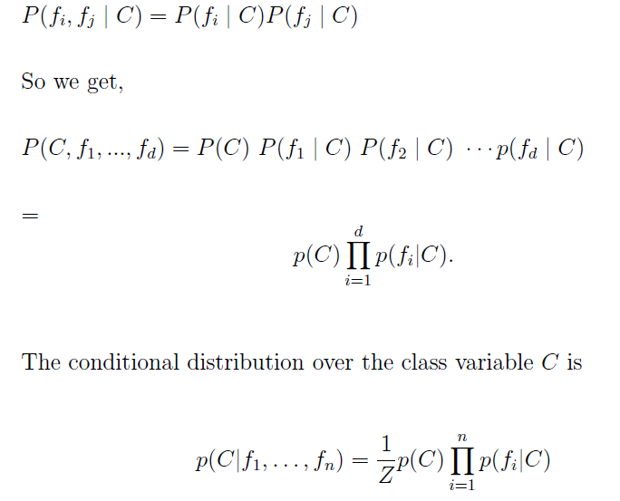
NAÏVE BAYES CLASSIFIER

